Slide 1
Mendelian Genetics

Slide 2
Important Vocabulary
These are a list of words used within the collegeboard questions. It would be helpful for you to familiarize yourself with them.
As you go through this slides presentation, you will come across words that are a different color and underlined. When you click on the word, it will take you to a picture of the definition of that word. For example, the word progeny. (Click on progeny, lol)
Crossed
Locus/loci
Alleles
Wildtype
Inheritance pattern
Affected individuals
Mutant allele
Single copy of allele (Heterozygous)
Mated
Autosomal recessive
P, F1, F2
Hybrid
True Breeding
Interbreed
Displayed (shows/has)
16. Carrier
17. Self-pollinated
18. Testcrossed
19. Segregate
20. Homologous chromosomes
21. Huntington’s Disease
22. Cystic Fibrosis
23. Law of independent assortment
24. Sickle Cell
25. Incidence (likelihood of happening)
26. “Distribution of traits” - numbers or ratios
27. Progeny

Slide 3
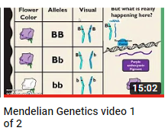
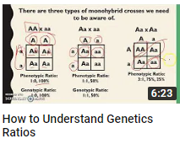
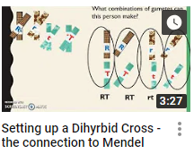
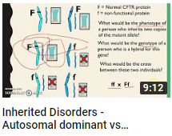
Linked below are Youtube Videos of the Lecture Portion of this chapter

Slide 4
The following slides contain practice problems. For each problem, the answers/solution will be on the next slide.
There will also be a video explanation in case the red ink isn’t enough.

Slide 5
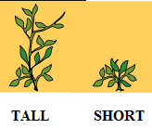
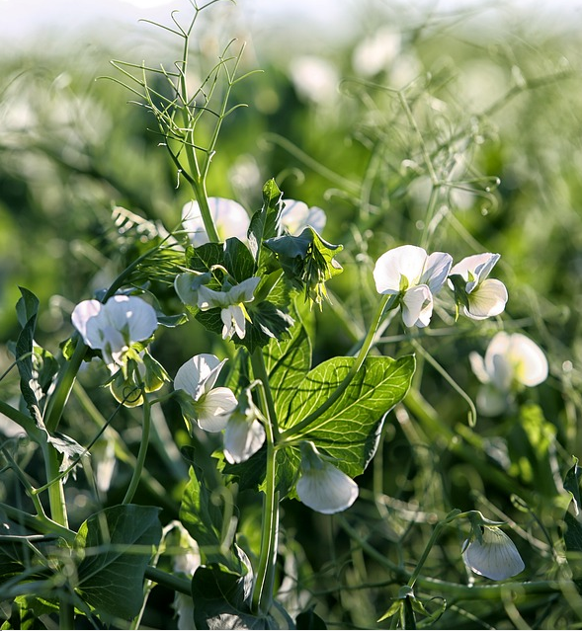
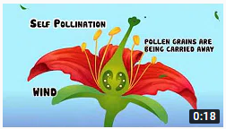
Mendel crossed true breeding tall pea plants with true breeding short pea plants to produce an F₁ generation that were all tall. The F₁ hybrids were allowed to self-fertilize. The F₂ progeny display the following phenotypes:
Tall: 787
Short 227
a. What does true breeding mean?
B. What is the genotype of a hybrid?
c. What does F₁ refer to?
d. What is the cross described here “The F1 hybrids were allowed to self-fertilize”?
e. When looking at the data presented, what ratio is it closest to?
f. Which is the dominant phenotype, Tall or short? How do you know?
18 sec video on self pollination/
self-fertilize

Slide 6
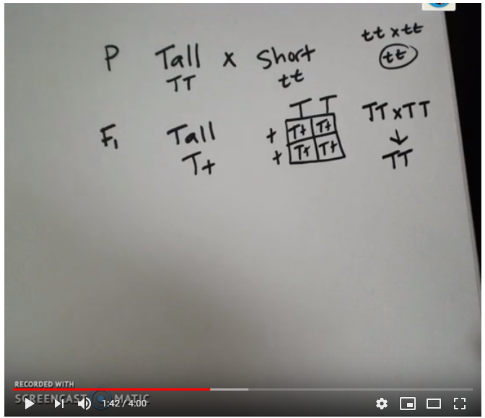
Mendel crossed true breeding tall pea plants with true breeding short pea plants to produce an F₁ generation that were all tall. The F₁ hybrids were allowed to self-fertilize. The F₂ progeny display the following phenotypes:
Tall: 787
Short 227
Click on this yellow box for video solution or image below for youtube
a. What does true breeding mean? Homozygous for a trait. When the plant self-fertilizes, it breeds true. Ex. A purple plant that self-fertilizes, will only ever produce purple offspring, never any white because it only has dominant alleles)
B. What is the genotype of a hybrid? Tt
c. What does F₁ refer to? The offspring of the two parents
d. What is the cross described here “The F1 hybrids were allowed to self-fertilize”? Tt x Tt
e. When looking at the data presented, what ratio is it closest to? 3:1
f. Which is the dominant phenotype, Tall or short? How do you know? Tall because the F1 are all tall.

Slide 7
Dimples are a single gene trait thought to be inherited as autosomal __________. When a true breeding dimpled individual is crossed with a true breeding non-dimpled individual, all of the F₁ offspring display dimples. Then the F₁ offspring are testcrossed, there are both dimpled and non-dimpled offspring in the F₂.
Dimples are a single gene trait thought to be inherited as autosomal __________. When a true breeding dimpled individual is crossed with a true breeding non-dimpled individual, all of the F₁ offspring display dimples. Then the F₁ offspring are testcrossed, there are both dimpled and non-dimpled offspring in the F₂.
Parental Cross | Phenotypes of F₁ Offspring | Phenotypes of Testcross Offspring (numbers of individuals)
Dimples x No Dimples | Dimples | Dimples (8) | No Dimples (6)
What are the genotypes of the parents?
Is the pattern or mode of inheritance for the dimples trait autosomal dominant or autosomal recessive? How do you know?
** Answers are on next slide**

Slide 8
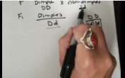
Dimples are a single gene trait thought to be inherited as autosomal __________. When a true breeding dimpled individual is crossed with a true breeding non-dimpled individual, all of the F₁ offspring display dimples. Then the F₁ offspring are testcrossed, there are both dimpled and non-dimpled offspring in the F₂.
Dimples are a single gene trait thought to be inherited as autosomal __________. When a true breeding dimpled individual is crossed with a true breeding non-dimpled individual, all of the F₁ offspring display dimples. Then the F₁ offspring are testcrossed, there are both dimpled and non-dimpled offspring in the F₂.
Click on this yellow box for video solution or image below for youtube
Parental Cross | Phenotypes of F₁ Offspring | Phenotypes of Testcross Offspring (numbers of individuals)
Dimples x No Dimples | Dimples | Dimples (8) | No Dimples (6)
What are the genotypes of the parents?
Dimples x No Dimples
DD x dd
(The question states they are both true breeding so you know they are homozygous for their traits)
Is the pattern or mode of inheritance for the dimples trait autosomal dominant or autosomal recessive? How do you know? Autosomal Dominant because the F₁ all have the dominant phenotype.
D D
d
d
Dd Dd Dd Dd

Slide 9
*** Using the pattern of inheritance from the previous slide ***
If a person true breeding for dimples is crossed with a hybrid, what proportion of their offspring will display the recessive phenotype?

Slide 10
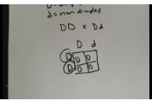
*** Using the pattern of inheritance from the previous slide ***
If a person true breeding for dimples is crossed with a hybrid, what proportion of their offspring will display the recessive phenotype?
D = Dimples
d = No dimples
True Breeding Dimples = DD
Hybrid = Dd
DD x Dd
0%
Click on this yellow box for video solution or image below for youtube
D D
D
d
DD DD Dd Dd

Slide 11
If a person is a hybrid for the dimples phenotype, what kind of gametes will they produce?

Slide 12
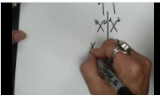
If a person is a hybrid for the dimples phenotype, what kind of gametes will they produce?
Due to Mendel’s law of segregation, the diploid Dd alleles separate into haploid D or d gametes.
Click on this yellow box for video solution or image below for youtube
D
D
d
d

Slide 13
Parental Cross | Phenotypes of F₁ Offspring | Phenotypes of Testcross Offspring (numbers of individuals)
Taster x Taster | Taster | Taster (7) | Non Taster (9)
Which is inherited as dominant - Taster or nontaster?
What are the possible genotypes of the parents?
What is the genotype of the F₁ offspring that is used in the testcross?
What is the mode of inheritance/pattern of inheritance for the ability to taste?
** Answers are on next slide**

Slide 14
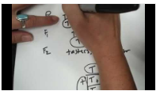
Parental Cross | Phenotypes of F₁ Offspring | Phenotypes of Testcross Offspring (numbers of individuals)
Taster x Taster | Taster | Taster (7) | Non Taster (9)
Box 1
Box 2
Box 3
Which is inherited as dominant - Taster or nontaster?
Taster is the dominant allele. We can see this because later in the F₂ the nontaster phenotype appears. That means that it has been “hidden” as a recessive allele.
What are the possible genotypes of the parents?
The parents can be TT or Tt and display the taster phenotype. As we look at the data, we see that some of the F₂ (box 3) are tt, therefore the Taster parent in box 2 carries a recessive, t allele.
What is the genotype of the F₁
offspring that is used in the testcross?
What is the mode of inheritance/pattern of inheritance for the ability to taste? (Autosomal) Dominant. The nontaster offspring is your clue.
Click on this yellow box for video solution or image below for youtube
T t
F₁ taster parent
t
t
Tt tt Tt tt
Testcross
Parent

Slide 15
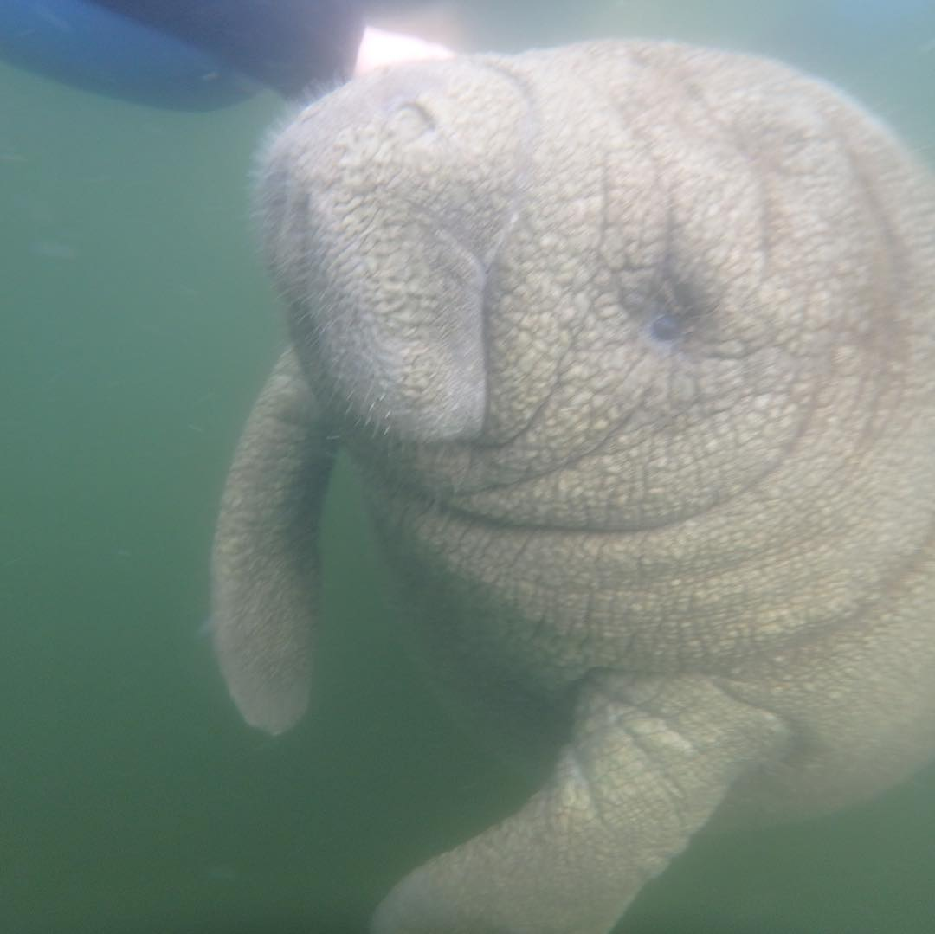
Scientists were studying Trichechus latirostris (the Florida manatee) and their inheritance pattern of a single gene trait for a hairy back vs a non-hairy back. The scientists mated a hairy T. latirostris from a Northern population with a non-hairy T. latirostris from an Eastern population. The resulting F₁ hybrids all displayed a hairy phenotype.
Scientists were studying Trichechus latirostris (the Florida manatee) and their inheritance pattern of a single gene trait for a hairy back vs a non-hairy back. The scientists mated a hairy T. latirostris from a Northern population with a non-hairy T. latirostris from an Eastern population. The resulting F₁ hybrids all displayed a hairy phenotype.
What does “single gene trait” mean?
What are the genotypes of the parents?
The F₁ hybrids interbreed producing an F₂ generation that had 20 hairy manatees and 6 non-hairy manatees.
What ratio is 20 to 6 closest to?
Which is the dominant allele? Recessive allele? How do you know?

Slide 16
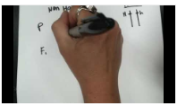
Scientists were studying Trichechus latirostris (the Florida manatee) and their inheritance pattern of a single gene trait for a hairy back vs a non-hairy back. The scientists mated a hairy T. latirostris from a Northern population with a non-hairy T. latirostris from an Eastern population. The resulting F₁ hybrids all displayed a hairy phenotype.
Scientists were studying Trichechus latirostris (the Florida manatee) and their inheritance pattern of a single gene trait for a hairy back vs a non-hairy back. The scientists mated a hairy T. latirostris from a Northern population with a non-hairy T. latirostris from an Eastern population. The resulting F₁ hybrids all displayed a hairy phenotype.
What does “single gene trait” mean? It is a trait determined by the proteins produced at a single locus on a chromosome.
What are the genotypes of the parents? HH x hh (we know the parents were true breeding because the F1 all have the same phenotype)
Click on this yellow box for video solution or image below for youtube
The F₁ hybrids interbreed producing an F₂ generation that had 20 hairy manatees and 6 non-hairy manatees.
What ratio is 20 to 6 closest to? 3:1
Which is the dominant allele? Recessive allele? How do you know? Hairy is dominant, non-hairy is recessive because the F1 all displayed a hairy phenotype. Additionaly, the ratio showed 75% as hairy.

Slide 17
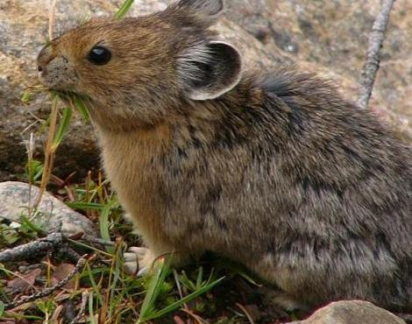
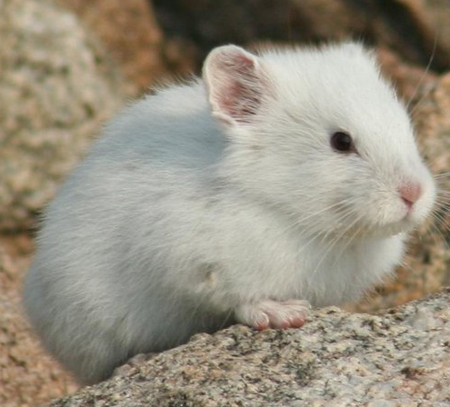
On a hike in the Eastern Sierras mountain range, you find an endangered pika, Ochotona Minor. The pika displays the wild-type phenotype of brown fur. You are unsure about the pika’s genotype, so you perform a testcross. 5 wild-type and 4 albino pika are produced in the F₁ generation. Write the cross of the parental generation. What is the genotype of the wild-type parent?

Slide 18
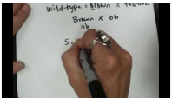
On a hike in the Eastern Sierras mountain range, you find an endangered pika, Ochotona Minor. The pika displays the wild-type phenotype of brown fur. You are unsure about the pika’s genotype, so you perform a testcross. 5 wild-type and 4 albino pika are produced in the F₁ generation. Write the cross of the parental generation.
On a hike in the Eastern Sierras mountain range, you find an endangered pika, Ochotona Minor. The pika displays the wild-type phenotype of brown fur. You are unsure about the pika’s genotype, so you perform a testcross. 5 wild-type and 4 albino pika are produced in the F₁ generation. Write the cross of the parental generation. What is the genotype of the wild-type parent?
Parental Cross: B? x bb (Because the question states that they performed a testcross, it implies that the wild-type is dominant. Because you don’t know if the pika is BB or Bb, that is why there is a ? in the place of the second allele.
Because the F1 produce both wild-type and albino, we know that the wild-type parent is heterozygous (hybrid).
Click on this yellow box for video solution or image below for youtube

Slide 19
A true-breeding pika is crossed with an albino pika. The F₁ all display the wild-type phenotype. The F₁ are allowed to interbreed. The F₂ offspring are produced in a 3:1 ratio. What is the mode of inheritance for the albino allele? The wild-type allele? Support your answer.

Slide 20
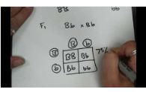
A true-breeding pika is crossed with an albino pika. The F₁ all display the wild-type phenotype. The F₁ are allowed to interbreed. The F₂ offspring are produced in a 3:1 ratio. What is the mode of inheritance for the albino allele? The wild-type allele? Support your answer.
The wild-type is inherited as autosomal dominant because the F1 are all wild-type. The albino phenotype is inherited as autosomal recessive because there are no albino offspring in the F1 even though there was an albino parent. We see the albino phenotype again in the F2 as 25% of the offspring.
Click on this yellow box for video solution or image below for youtube

Slide 21
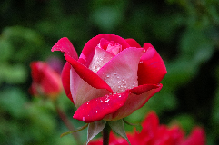
The GES5R32 gene encodes a receptor protein that influences the ability to smell the flower scent emitted by roses. The gene has two alleles: a dominant, wild-type allele that enables an individual (smeller) to smell the roses, and a recessive, mutant allele that interferes with the ability of an individual (non-smeller) to smell the roses. A true breeding smeller is mated with a true breeding non-smeller. F1 is testrossed. What is the phenotypic ratio of the F2 progeny?

Slide 22
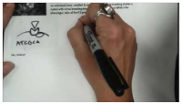
The GES5R32 gene encodes a receptor protein that influences the ability to smell the flower scent emitted by roses. The gene has two alleles: a dominant, wild-type allele that enables an individual (smeller) to smell the roses, and a recessive, mutant allele that interferes with the ability of an individual (non-smeller) to smell the roses. A true breeding smeller is mated with a true breeding non-smeller. F1 is testrossed. What is the phenotypic ratio of the F2 progeny?
Click on this yellow box for video solution or image below for youtube
Phenotypic Ratio 1:1

Slide 23
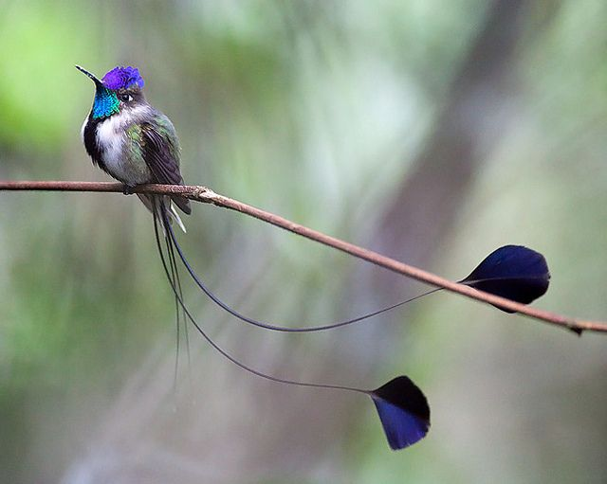
Shape of tail feathers in a certain species of hummingbirds is influenced by one gene with two alleles: a dominant allele that results in a fan shape and a recessive allele that results in no fans at the end. A fan-tailed female from a true breeding population is mated with a non-fan tail male. What is the probability of an offspring being born with non-fan tails? Explain.

Slide 24
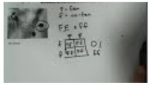
Shape of tail feathers in a certain species of hummingbirds is influenced by one gene with two alleles: a dominant allele that results in a fan shape and a recessive allele that results in no fans at the end. A fan-tailed female from a true breeding population is mated with a non-fan tail male. What is the probability of an offspring being born with non-fan tails? Explain.
Click on this yellow box for video solution or image below for youtube
0%

Slide 25
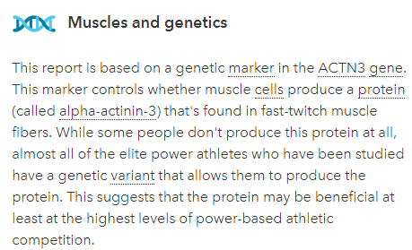
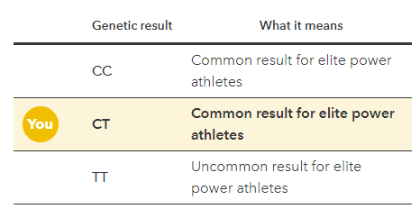
Here are my results from 23andme for my muscle composition. My son, Max, does not produce the alpha-actin-3 protein. What is his genotype and phenotype? What is my husband’s genotype and phenotype?

Slide 26
Here are my results from 23andme for my muscle composition. My son, Max, does not produce the alpha-actin-3 protein. What is his genotype and phenotype? What is my husband’s genotype and phenotype?
Max - TT
Husband, CT or TT (Truthfully, he’s CT)

Slide 27
Freckles is reportedly controlled by a single gene with two alleles. The dominant allele results in the presence of freckles, while the recessive allele results the absence of freckles. Two individuals both heterozygous for freckles produce many children over the course of their lives together. Predict the frequency of children with no freckles from these two parents.

Slide 28
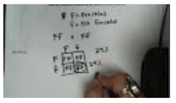
Freckles is reportedly controlled by a single gene with two alleles. The dominant allele results in the presence of freckles, while the recessive allele results the absence of freckles. Two individuals both heterozygous for freckles produce many children over the course of their lives together. Predict the frequency of children with no freckles from these two parents.
Click on this yellow box for video solution or image below for youtube
25%

Slide 29
In a pika, there are three unlinked genes A, B, C, all at their own loci. If a female pika is heterozygous for each of these genes, what is the likelihood of her gamete being abc?

Slide 30
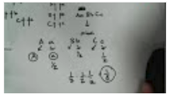
In a pika, there are three unlinked genes A, B, C, all at their own loci. If a female pika is heterozygous for each of these genes, what is the likelihood of her gamete being abc?
Click on this yellow box for video solution or image below for youtube
1/8

Slide 31
In a pika, there are four unlinked genes A, B, C, D all at their own loci. If a female pika is heterozygous for each of these genes, what is the likelihood of her gamete being AbcD?

Slide 32
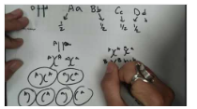
In a pika, there are four unlinked genes A, B, C, D all at their own loci. If a female pika is heterozygous for each of these genes, what is the likelihood of her gamete being AbcD?
Click on this yellow box for video solution or image below for youtube
1/16

Slide 33
Cystic Fibrosis is inherited an autosomal recessive disease. If a carrier is crossed with a affected individual, and they have two children, what is the probability that both children have cystic fibrosis?
If two carriers are crossed and have two children, what is the probability that both children will be affected?
If two carriers are crossed and have two children, what is the probability that neither child will be affected?

Slide 34
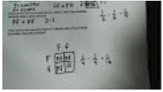
Click on this yellow box for video solution or image below for youtube
Cystic Fibrosis is inherited an autosomal recessive disease. If a carrier is crossed with a affected individual, and they have two children, what is the probability that both children have cystic fibrosis?
If two carriers are crossed and have two children, what is the probability that both children will be affected?
If two carriers are crossed and have two children, what is the probability that neither child will be affected?
1/4
1/16
9/16

Slide 35
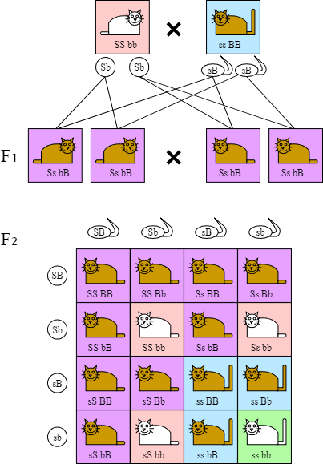
Time to take it up a notch and begin to work on Dihybrid crosses!
(cross of TWO traits)
Amoeba Sisters:
Dihybrid and Two trait crosses
Bozeman: A beginners guide to Punnett Squares

Slide 36
Parental Cross | Phenotype of the F₁ | Phenotypes of Testcross offspring
Wild-type x albino | Wild-type | Wild-type Albino 17 19
Write out the cross (the genotype) of the parental generation.
Which phenotype is dominant? How do you know?
Write out the testcross of the F₁ individuals. Why were the results in a 1:1 phenotypic ratio?

Slide 37
Parental Cross | Phenotype of the F₁ | Phenotypes of Testcross offspring
Wild-type x albino | Wild-type | Wild-type Albino 17 19
Write out the cross (the genotype) of the parental generation.
Which phenotype is dominant? How do you know?
Write out the testcross of the F₁ individuals. Why were the results in a 1:1 phenotypic ratio?
AA x aa
Wildtype
Because the cross was between a Aa x aa

Slide 38
Parental Cross | Phenotype of the F₁ | Phenotypes of Testcross offspring
Wild-type x albino | Wild-type | Wild-type Albino 17 19
Brown Eyes x Red Eyes | Brown Eyes | Brown Eyes Red Eyes 20 18
Based on the data for brown and red eye phenotypes, what is the pattern of inheritance for brown eyes? How do you know?

Slide 39
Parental Cross | Phenotype of the F₁ | Phenotypes of Testcross offspring
Wild-type x albino | Wild-type | Wild-type Albino 17 19
Brown Eyes x Red Eyes | Brown Eyes | Brown Eyes Red Eyes 20 18
Based on the data for brown and red eye phenotypes, what is the pattern of inheritance for brown eyes? How do you know?
Autosomal dominant

Slide 40
Parental Cross | Phenotype of the F₁ | Phenotypes of Testcross offspring
Wild-type x albino | Wild-type | Wild-type Albino 17 19
Brown Eyes x Red Eyes | Brown Eyes | Brown Eyes Red Eyes 20 18
Wild-type, Brown Eyes x Albino, Red Eyes | Wild-type, Brown eyes | Wildtype, Brown Wildtype, Red 9 11 Albino, Brown Albino, Red 10 8
Box 1
Box 2
Box 3
Box 4
Box 5
Box 6
Box 7
Box 8
Box 9
Explain why there are no red eyed offspring in boxes 5 and 8.
b. Set up and complete the cross that resulted in the data found in box 9.

Slide 41
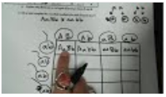
Parental Cross | Phenotype of the F₁ | Phenotypes of Testcross offspring
Wild-type x albino | Wild-type | Wild-type Albino 17 19
Brown Eyes x Red Eyes | Brown Eyes | Brown Eyes Red Eyes 20 18
Wild-type, Brown Eyes x Albino, Red Eyes | Wild-type, Brown eyes | Wildtype, Brown Wildtype, Red 9 11 Albino, Brown Albino, Red 10 8
Box 1
Box 2
Box 3
Click on this yellow box for video solution or image below for youtube
Box 4
Box 5
Box 6
Box 7
Box 8
Box 9
Explain why there are no red eyed offspring in boxes 5 and 8.
Because red eyes is a recessive allele and you need to copies to display that phenotype.
Shown/solved in the video
b. Set up and complete the cross that resulted in the data found in box 9.

Slide 42
B = Dark Brown Fur
b = Spotted Fur
E = Floppy Ears
e = Pointed Ears
Heterozygous Dark Brown dog with floppy ears, is crossed with a heterozygous Dark Brown dog with floppy ears. What are the expected phenotypic ratios of the offspring?

Slide 43
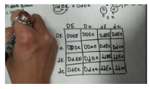
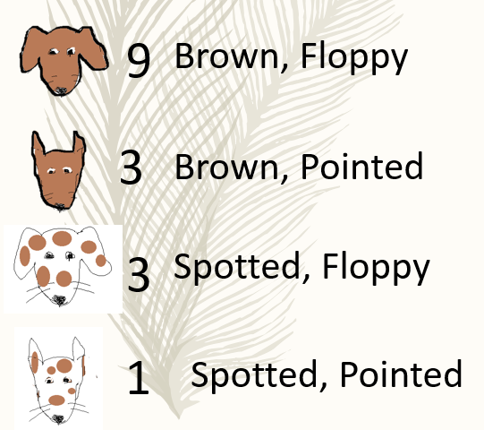
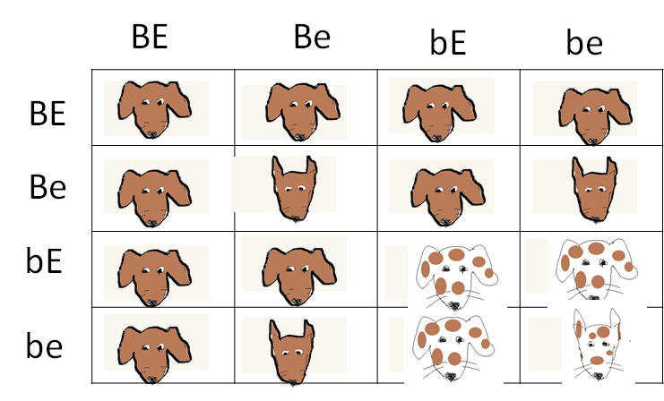
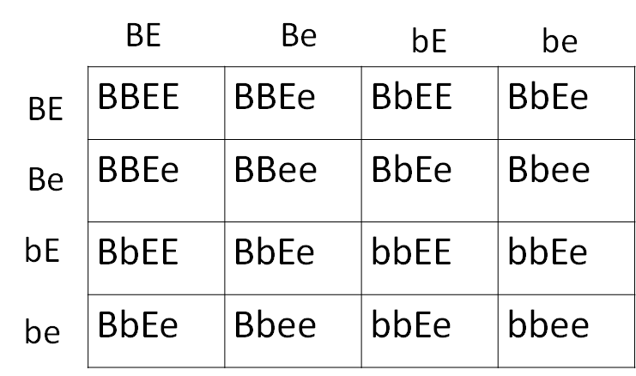
B = Dark Brown Fur
b = Spotted Fur
E = Floppy Ears
e = Pointed Ears
Heterozygous Dark Brown dog with floppy ears, is crossed with a heterozygous Dark Brown dog with floppy ears. What are the expected phenotypic ratios of the offspring?
Click on this yellow box for video solution or image below for youtube
BbEe x BbEe
9:3:3:1

Slide 44
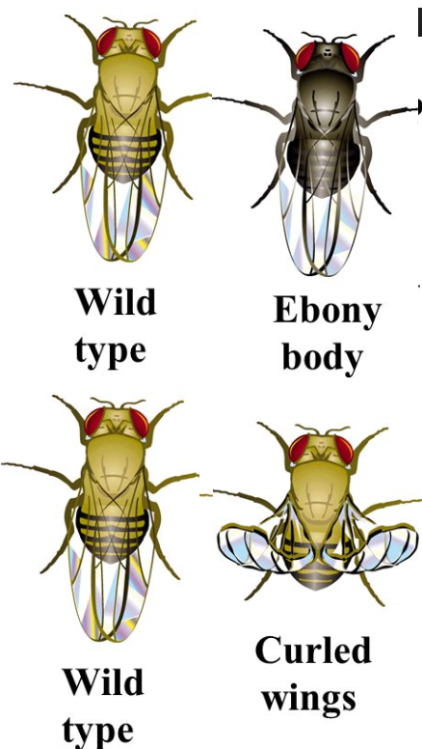
In Drosophila melanogaster the allele for wild type brown body color (B) is dominant to the recessive allele for Ebony body color (b). The allele for wild-type wing shape (G) is dominant to the recessive allele for curly wing phenotype (g). A female fly heterozygous for both traits is crossed with a male fly with ebony body color and curled wings. What phenotypes are possible in their offspring? Complete the cross described above.

Slide 45
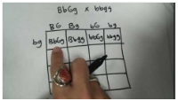
In Drosophila melanogaster the allele for wild type brown body color (B) is dominant to the recessive allele for Ebony body color (b). The allele for wild-type wing shape (G) is dominant to the recessive allele for curly wing phenotype (g). A female fly heterozygous for both traits is crossed with a male fly with ebony body color and curled wings. What phenotypes are possible in their offspring? Complete the cross described above.
Brown, Wild type wings
Brown, curled wings
Ebony, Wild type
Ebony, curled
1:1:1:1
All phenotypes are
25% likely
BbGg x bbgg
BG Bg bG bg
Click on this yellow box for video solution or image below for youtube
bg
bg
bg
bg
BbGg | Bbgg | bbGg | bbgg
BbGg | Bbgg | bbGg | bbgg
BbGg | Bbgg | bbGg | bbgg
BbGg | Bbgg | bbGg | bbgg

Slide 46
Mrs. Neimeyer is heterozygous for the factor 5 gene which is inherited as autosomal dominant and results in the development of blood clots. Mr. Neimeyer is not affected with this blood clotting disorder. Unfortunately, the are both hybrids for late onset alzheimer’s. What is the probability of them producing a child that is not at risk for developing blood clots, but will develop late onset alzheimer’s? (For this example, let's assume that alzheimer’s is autosomal recessive).

Slide 47
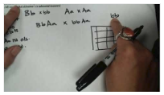
Mrs. Neimeyer is heterozygous for the factor 5 gene which is inherited as autosomal dominant and results in the development of blood clots. Mr. Neimeyer is not affected with this blood clotting disorder. Unfortunately, the are both hybrids for late onset alzheimer’s. What is the probability of them producing a child that is not at risk for developing blood clots, but will develop late onset alzheimer’s? (For this example, let's assume that alzheimer’s is autosomal recessive).
Click on this yellow box for video solution or image below for youtube
1/8

Slide 48
Hereditary hemochromatosis is a genetic condition characterized by absorption of too much dietary iron. This may lead to iron overload, which can cause damage to the joints and certain organs, such as the liver, skin, heart, and pancreas.
Age-related macular degeneration (AMD) is the most common cause of irreversible vision loss among older adults. The disease results in damage to the central part of the retina (the macula), impairing vision needed for reading, driving, or even recognizing faces.
Both of these conditions are inherited as autosomal recessive.
Truthfully, Mr. and Mrs. Neimeyer are both hybrids for both of these traits.
What is the probability that their children will be born not affected by either disorder?
What is the probability that their children will be born affected by both disorders?

Slide 49
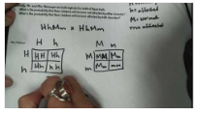
Hereditary hemochromatosis is a genetic condition characterized by absorption of too much dietary iron. This may lead to iron overload, which can cause damage to the joints and certain organs, such as the liver, skin, heart, and pancreas.
Age-related macular degeneration (AMD) is the most common cause of irreversible vision loss among older adults. The disease results in damage to the central part of the retina (the macula), impairing vision needed for reading, driving, or even recognizing faces.
Both of these conditions are inherited as autosomal recessive.
Truthfully, Mr. and Mrs. Neimeyer are both hybrids for both of these traits.
What is the probability that their children will be born not affected by either disorder?
What is the probability that their children will be born affected by both disorders?
9/16
1/16
Click on this yellow box for video solution or image below for youtube

